Slide 1
CRIGiS project: Vulnerability/Impact Studies with a focus on Tourism and Critical Infrastructures
Zita Bihari, Hungarian Meteorological Service

Slide 2
Main data
Duration of the project: 30.04.2015.-31.12.2015.
Budget: 196 000 EUR
Consortium:
Hungarian Meteorological Service (OMSZ)
National Centre of Environmental Health (OKK)
National Directorate General for Disaster Management, Ministry of the Interior
University of Szeged, Department of Climatology and Landscape Ecology (SZTE)

Slide 3
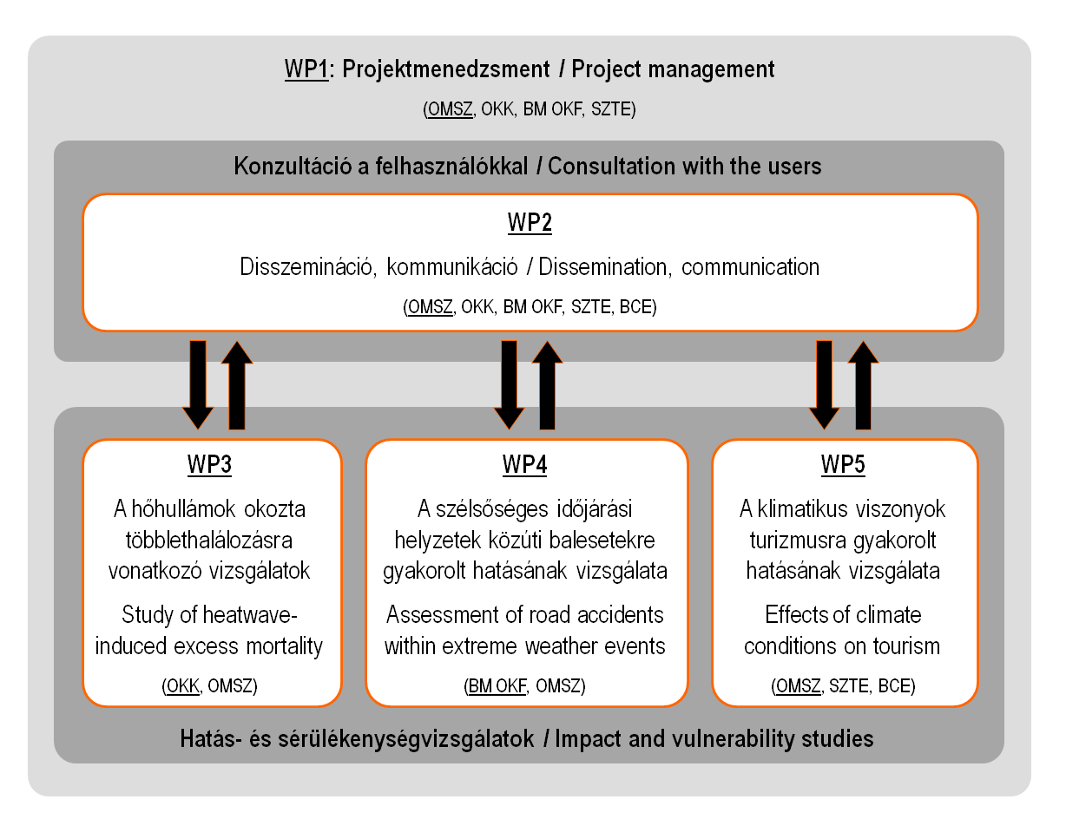
Structure of the project

Slide 4
Methodology
Determination of climate and impact indicators
Calculation of climate indicators on the base of observed data for the NAGIS grid
Determination of a connection between tha climate and impact indicators, test for some pilot region
Determination of climate indicators in the future (2021-2050, 2071-2100) for the NAGIS grid
Establishment of the impact indicators in the future on the base of the disclosed connections
Analysis of the changes

Slide 5
Dissemination
Kickoff meeting, 11.06.2015.
Workshop for end users, 22.06.2015.
Leaflet
Web page
Newsletter
Final publication
Conferences

Slide 6
Conferences
"Our Common Future Under Climate Change", Paris, 07-10.07.2015.
EMS Annual Meeting & 12th European Conference on Applications of Meteorology, Sophia, Bulgaria, 07–11.09.2015.
Workshop on Regional Climate Projections and their Use in Impacts and Risk Analysis Studies, São José dos Campos, Brasilia, 15-18.09.2015.
4th International Conference on Climate, Tourism and Recreation, Istanbul, 16-20.09.2015.
Magyar Higiénikusok Társasága X. Kongresszusa, 6-8.10.2015, Eger, Hungary
Data Management Workshop, St Gallen, 28-30.10.2015.
"Innovations in Climate Services workshop", 2-4 November 2015, Egmond aan Zee, the Netherlands

Slide 7
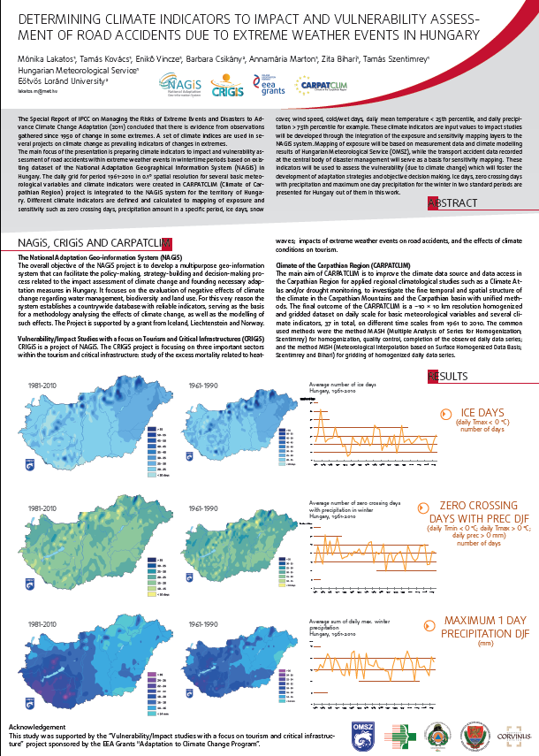
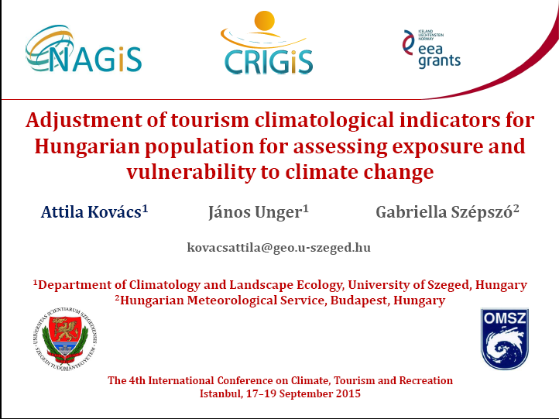
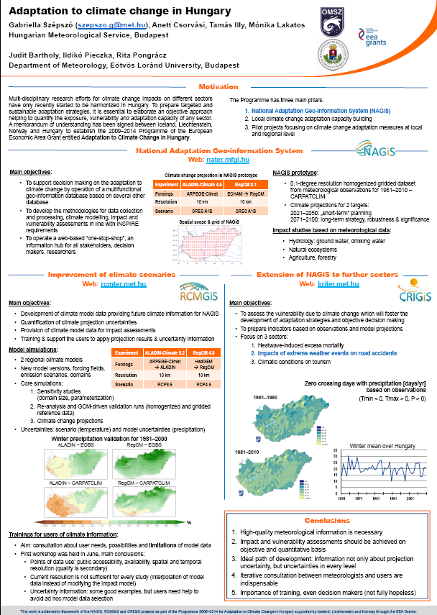
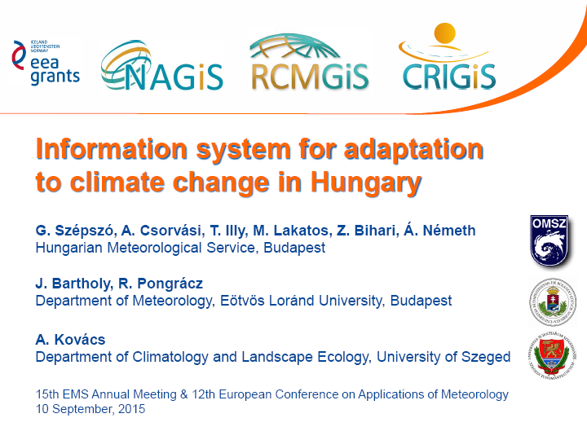

Slide 8
Web:
www.kriter.met.hu
Contact:
kriter@met.hu
Thank you for your attention!

